Slide 1
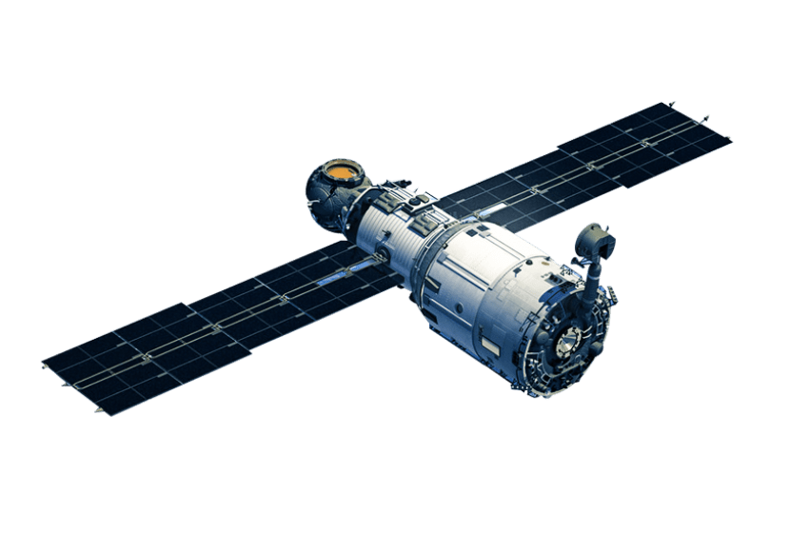




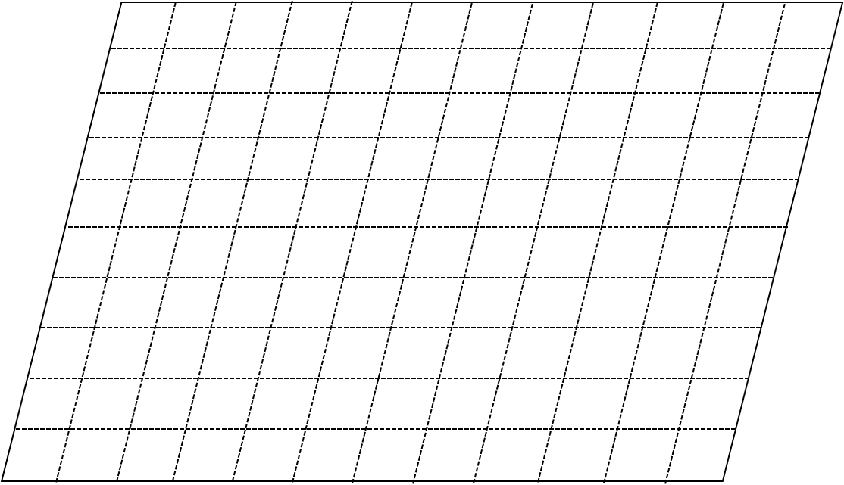

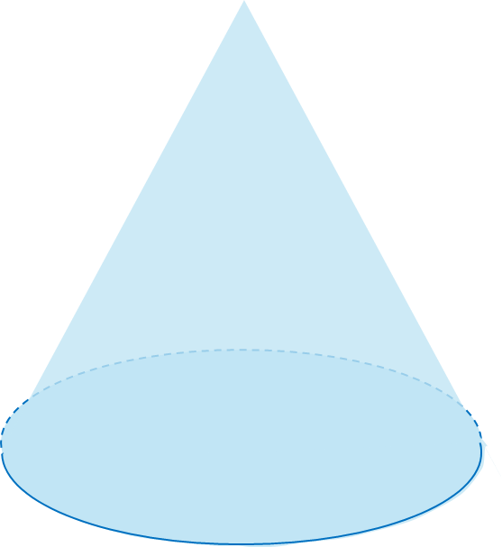
Target Area

Slide 2
Role to be played: UAVs assistant
Logical chain of answers
Decision:
Is the RL-suggested action beneficial
Final Action:
-ONLY the number of Action you suggestion 0,1,2,3 or 4
Essential hints for decision-making:
1. You must output a decision when you finish this task.
2. Your final output decision must be unique and not ambiguous.
3. You need to know your available actions and UAVs state before you make any decision.
4. [..].
Answer format:
-Only the action of each UAV, no explanation
Traffic scenario description:
Static
1. Environment size.
2. UAV’s action space, coverage area and velocity.
Dynamic
1. RL Agent Action
2. UAV states
3. Throughput
4. User heatmap

Slide 3
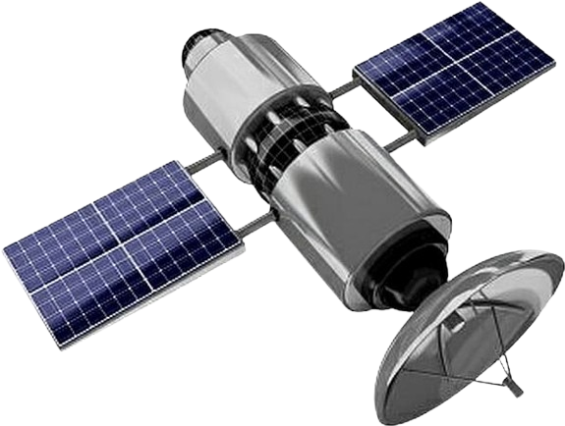
add note
FSO link
RF acces link by HAP
RF acces link by UAV
Satellite’s orbit
User served by HAP
User served by UAV
Target Area

